Slide 1
Motivation

Slide 2
Motivation
Components
Arousal/ need/ Drive
Direction
Maintenance
Goal

Slide 3
Sources of Motivation in an Organization
Needs
Goals
Perceived Justice

Slide 4
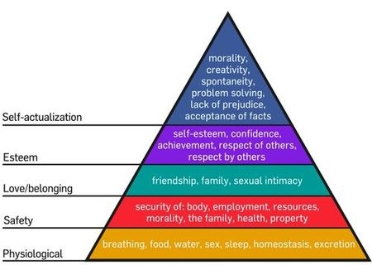
Maslow’s Need Hierarchy

Slide 5
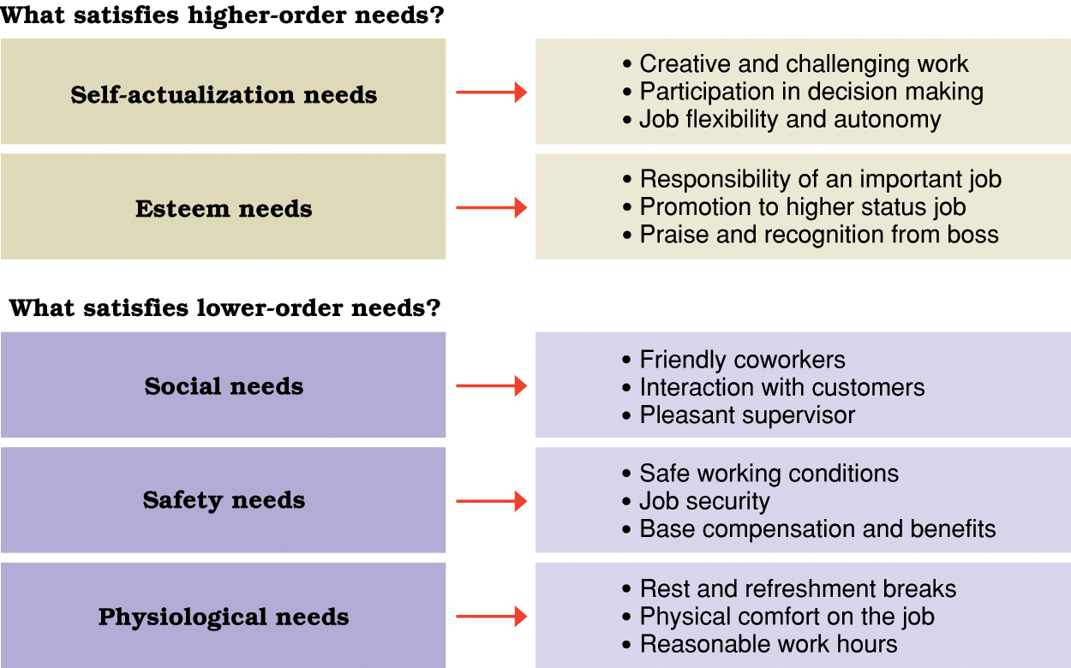

Slide 6
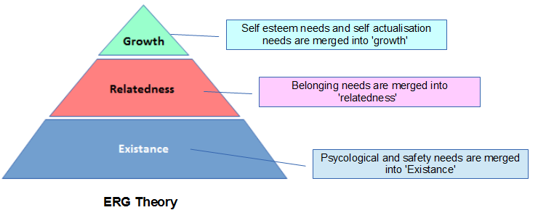
Alderfer’s ERG Theory

Slide 7
Question
If you reward something do you get more of the behavior you want?
If you punish something do you get less of the behavior you want?

Slide 8
Ted Talk
The Puzzle of Motivation: Dan Pink
https://www.ted.com/talks/dan_pink_on_motivation/transcript?language=en#t-686024
Career analyst Dan Pink examines the puzzle of motivation, starting with a fact that social scientists know but most managers don't: Traditional rewards aren't always as effective as we think.
Also watch:
https://ed.ted.com/on/5dRQqf81

Slide 9
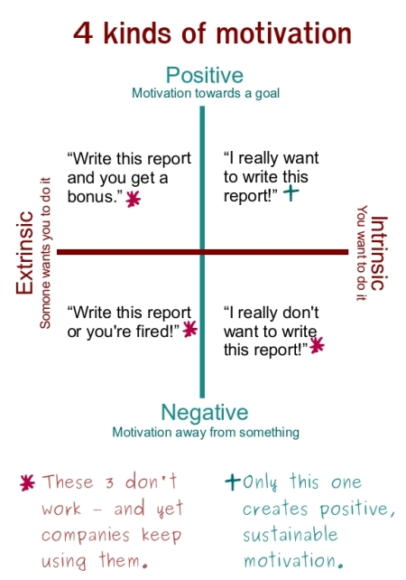

Slide 10
“You've got to think about big things while you're doing small things, so that all the small things go in the right direction”
“The illiterate of the 21st century will not be those who cannot read and write, but those who cannot learn, unlearn, and relearn”
— Alvin Toffler

Slide 11
Goal Setting Theory
Managers widely accept goal setting as a means to improve and sustain performance
Lock and Latham:
Specific and difficult goals led to better task performance than vague or easy goals.
Important questions to be asked while setting a goal
What?
Why?
How?

Slide 12
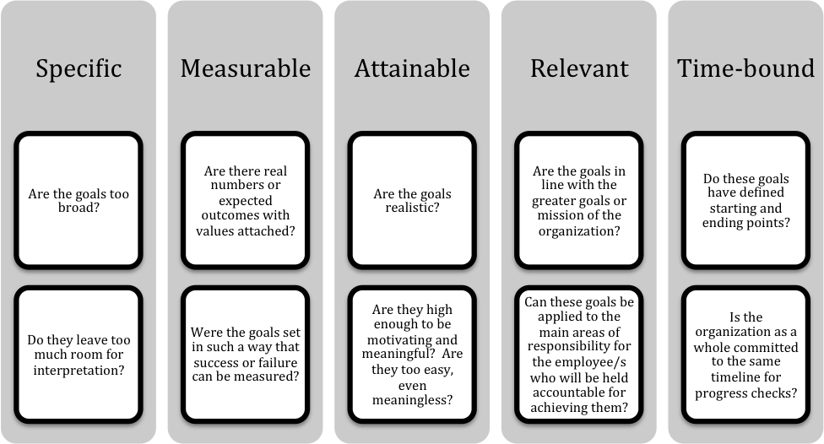
Nature of Goal: SMART

Slide 13
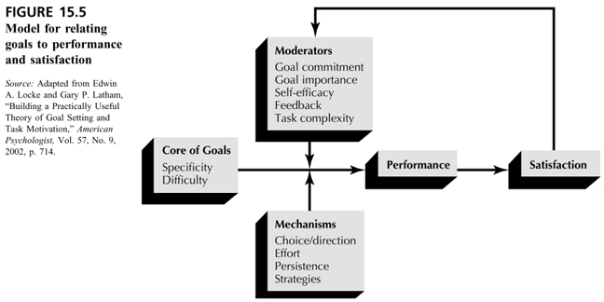
Goal Setting

Slide 14
Five Principles of Goal Setting
To motivate, goals must have:
1.Clarity.
2.Challenge.
3.Commitment.
4.Feedback.
5.Task complexity.

Slide 15
Recruitment in Style @ Flipkart
Any top-level recruit is prescribed a list of books to read before coming on board
With no proven successful models in Indian e-commerce, the company’s radar is in search of quick learners and unlearners
Senior-level recruits are made to meet & interact with several teams to gel with co-workers
Warehouse visits must for all new recruits to understand the entire supply-chain of Flipkart
Source: http://www.business-standard.com/article/companies/flipkart-builds-its-top-management-differently-114122500674_1.html

Slide 16
Advice to Managers
Goals Need to Be Specific
Goals Must Be Difficult but Attainable
Goals Must Be Accepted
Feedback Must Be Provided on Goal Attainment
Goals Are More Effective When They Are Used to Evaluate Performance

Slide 17
A Learning Goal Orientation Leads to Higher Performance than a Performance Goal Orientation
Deadlines Improve the Effectiveness of Goals
Group Goal-Setting is As Important As Individual Goal-Setting
Express confidence in your subordinates’ abilities to attain their goals, and give subordinates regular feedback on the extent of goal attainment.
When workers are performing difficult and complex tasks that involve learning, do not set goals until the workers gain some mastery over the task.

Slide 18
Case Study
Case 1: Mr. Aditya | Case 2: Mr. Swapnil
College Graduate | College Graduate
Both are working at Force Technology Ltd.
Both are equally good in terms of Technical Skills and have great zeal and Motivation to work Both works at long and hard at their jobs
Gets 30 K P/M | Gets 35 K P/M
Emotional Plight ??? | Emotional Plight???

Slide 19
Motivating by Being Fair
Equity Theory
Procedural Justice

Slide 20
Individual process vs. social component
Social Comparison perspective in motivation
Types of comparison
Two types of organizational justice
Perceived fairness Perceived fairness
of the procedure used of the decision outcomes
To make decisions themselves
Organizational Justice
Procedural Justice
Equity

Slide 21
Adams Equity Theory
It focuses on what one actually gets in the job and what one thinks is fair - what one should have
Individuals are motivated to maintain fair or equitable relationships
Examples
People compare themselves with others on two parameters:
Outcome
Inputs

Slide 22
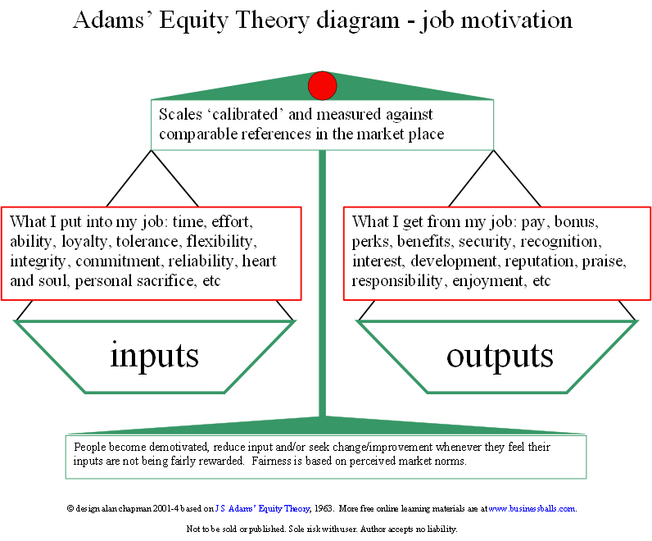
Inputs: Things that we contribute
Time, effort, ability, loyalty,
Qualification, experience,
tolerance, flexibility, integrity,
commitment, reliability,
heart and soul, personal sacrifice,
etc.
Outputs: Things we get out of our job
Pay, bonus, perks, benefits, security, recognition, interest, development, reputation, praise, responsibility, enjoyment, etc.

Slide 23
People hold certain beliefs about what is a fair reward for one’ job contribution - an exchange
Is there a discrepancy in how people perceive their input/ output ratio
People compare their I/O with those of others and judge the equitableness
Compare I/O ratio with called referents

Slide 24
Types of Referents
Self-Inside
The person’s experience in a different job in the same organization
Self-Outside
The person’s experience in a different job in a different organization
Other-Inside
Another individual or group within the organization
Other-Outside
Another individual or group outside of the organization

Slide 25
Model of Equity Theory
Is versus Ir
Os Or
I = Inputs - employee’s contribution to employer
R = Referent - comparison person
S = Subject - the employee who is judging fairness of the exchange

Slide 26
Equity Theory - Exchange Scenarios
Comparison may result in any of these three states
Case 1: Equity -- pay allocation is perceived to be to be fair - motivation is sustained
Case 2: Inequity -- Underpayment. Employee is motivated to seek justice. Work motivation is disrupted.
Case 3: Inequity - Overpayment. Could be problem. Inefficient. In other cultures employees lose face.
Inequity and emotional state
Overpayment: Guilt
Underpayment: Anger

Slide 27
Resolving Perceived Inequity
Behavioral Options-
Changing their input to match outcomes (e.g., leaving early or slacking off)
Change outcomes to match inputs (e.g., asking for a pay increase, stealing)
Persuading others to change inputs (e.g., complaining to superiors)
Withdrawal (e.g., tardiness or turnover)
Cognitive Options-
Distort one's own inputs or outcomes (e.g., "I'm not really working that hard," "I have a lot of free time“)
Distort the inputs or outcomes of others (e.g., he/she gets more money than me but they have to live in Buffalo)
Change the comparison others ("Motivation theories," 2009). The longer a person has had their comparison other the harder it is to change

Slide 28
Possible Reactions to Inequity
Types of Reaction
Type of Inequity Behavioural Psychological
Overpayment Raise inputs (work hr.) Convincing that my
or lower outcomes outcomes are deserved based on the my inputs (rationalize that work harder than others)
Underpayment Lower your inputs Convince yourself that others reduce inputs are really higher than effort) yours (Rationalizing that or raise comparison worker is really outcomes more qualified and thus deserves higher outcomes

Slide 29
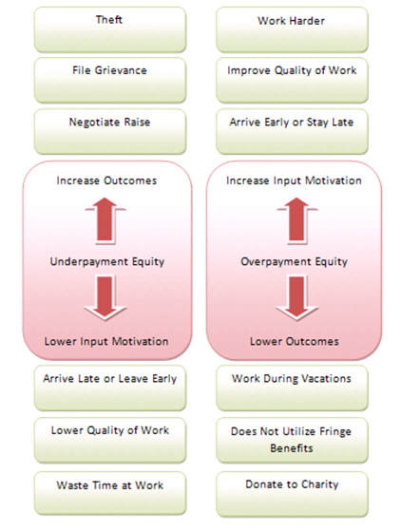

Slide 30
Procedural Justice: Making Decisions Fairly
Perceptions regarding the fairness of procedures used to determine outcomes
Two sides:
Structural Side
Social Side

Slide 31
Structural Side
How decisions need to be made for employees to be considered fair
Things to be considered
Give people a say in how decisions are made
Provide an opportunity for errors to be corrected
Apply rules and policies consistently
Make unbiased decisions

Slide 32
Social Side
Interactional Justice
Informational Justice
Social Sensitivity

